Slide 1

DISASTER TWEET CLASSIFICATION
BY: - DEEWANKAR SHARMA

Slide 2
INTRODUCTION
THIS PROJECT INVOLVES DEVELOPING A MACHINE LEARNING MODEL TO CLASSIFY TWEETS AS EITHER DISASTER-RELATED OR NOT, USING DATA FROM THE TWITTER_DISASTER.CSV DATASET. IT APPLIES NATURAL LANGUAGE PROCESSING (NLP) AND MACHINE LEARNING TECHNIQUES TO CLEAN, EXPLORE, VISUALIZE, AND MODEL THE DATA FOR EFFICIENT DISASTER DETECTION. HERE’S A CONCISE SUMMARY OF EACH STEP, FOCUSING ON DATA EXPLORATION, PREPROCESSING, FEATURE ENGINEERING, AND VISUALIZATION TECHNIQUES

Slide 3
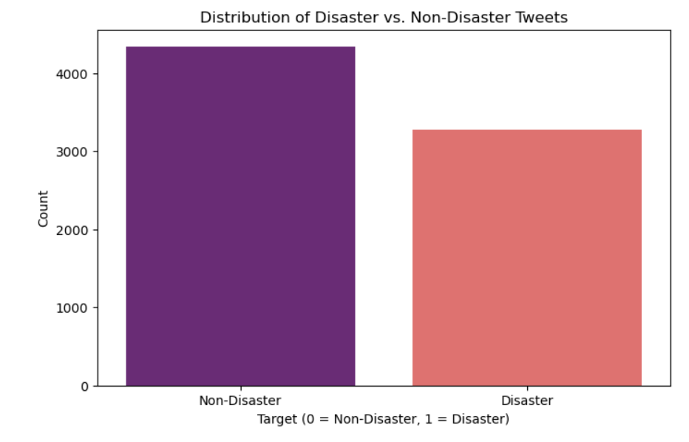
DATA EXPLORATION AND PREPARATION
LOADING THE DATA:
THE DATASET IS LOADED USING PANDAS, AND BASIC INFORMATION ABOUT THE DATASET IS OBTAINED THROUGH METHODS LIKE INFO(), HEAD(), AND COUNT(). MISSING VALUES ARE IDENTIFIED, ESPECIALLY FOR THE COLUMNS KEYWORD AND LOCATION.
Missing values in keyword (0.8%) are minimal, while location (33.27%) has significant missing data.
Only the text and target columns are used in modeling since others have too many missing values.
DISTRIBUTION OF DISASTER AND NON-DISASTER TWEETS:
A COUNTPLOT OF THE TARGET COLUMN REVEALS A ROUGHLY BALANCED DATASET (DISASTER: 1, NON-DISASTER: 0).
THE DISTRIBUTION OF TWEET LENGTHS FOR DISASTER VS. NON-DISASTER TWEETS IS VISUALIZED USING HISTOGRAMS.

Slide 4
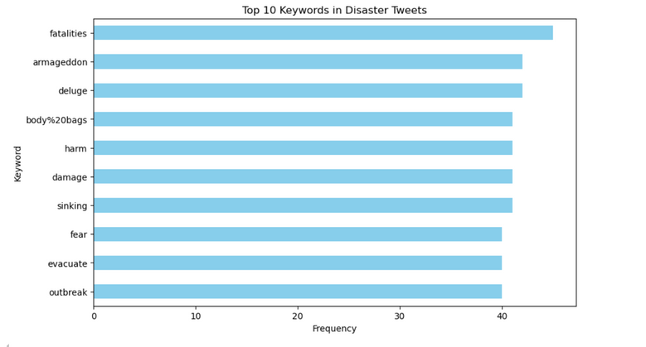
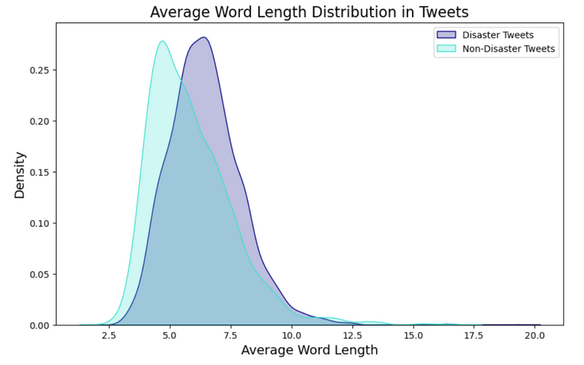
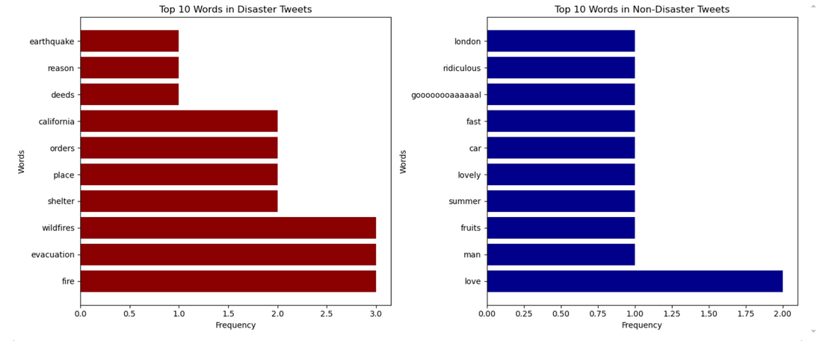
TOP KEYWORDS AND WORD LENGTHS:
TOP 10 KEYWORDS: THE MOST FREQUENT KEYWORDS IN DISASTER-RELATED TWEETS ARE VISUALIZED.
WORD LENGTHS: A COMPARISON OF THE WORD LENGTHS BETWEEN DISASTER AND NON-DISASTER TWEETS IS DONE USING HISTOGRAMS AND KERNEL DENSITY ESTIMATION (KDE) PLOTS.
STOPWORDS REMOVAL:
STOPWORDS ARE REMOVED FROM BOTH DISASTER AND NON-DISASTER TWEETS, AND THE MOST COMMON WORDS ARE VISUALIZED USING BAR PLOTS AND WORD CLOUDS.
THE MOST FREQUENT WORDS IN DISASTER-RELATED AND NON-DISASTER TWEETS ARE ALSO PLOTTED USING WORD CLOUDS, WITH WORDS LIKE DERAILMENT, WRECKAGE, AND OUTBREAK BEING PROMINENT IN DISASTER TWEETS.

Slide 5
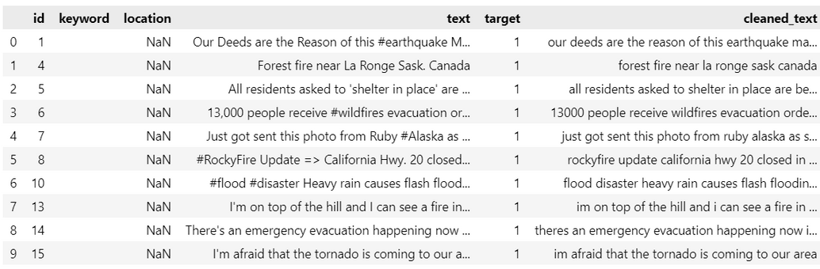
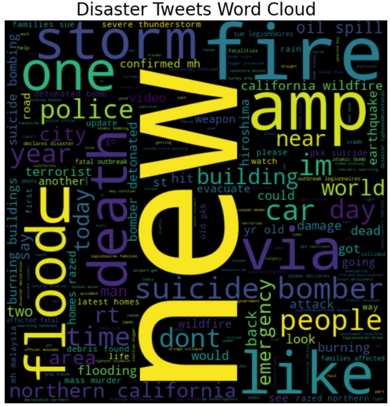
DATA CLEANING AND PREPROCESSING
TEXT CLEANING:
TEXT IS CLEANED BY REMOVING URLS, MENTIONS (@USERNAME), HASHTAGS (#), SPECIAL CHARACTERS, AND NUMBERS. ADDITIONALLY, STOPWORDS ARE REMOVED TO FOCUS ON THE MORE MEANINGFUL WORDS IN THE TWEETS.
A NEW COLUMN CLEANED_TEXT IS ADDED TO STORE THE CLEANED TWEETS.
TOKENIZATION:
THE CLEANED TEXT IS TOKENIZED USING NLTK'S WORD_TOKENIZE.
FEATURE ENGINEERING:
ADDITIONAL FEATURES LIKE TWEET_LENGTH, HASHTAG_COUNT, AND MENTION_COUNT ARE CREATED TO CAPTURE TWEET STRUCTURE AND ELEMENTS THAT MIGHT INDICATE A DISASTER-RELATED TWEET.
THE FEATURE TWEET_LENGTH IS DERIVED FROM THE CLEANED TEXT, WHILE HASHTAG_COUNT AND MENTION_COUNT ARE CALCULATED BY COUNTING # AND @ SYMBOLS IN THE ORIGINAL TWEETS.

Slide 6

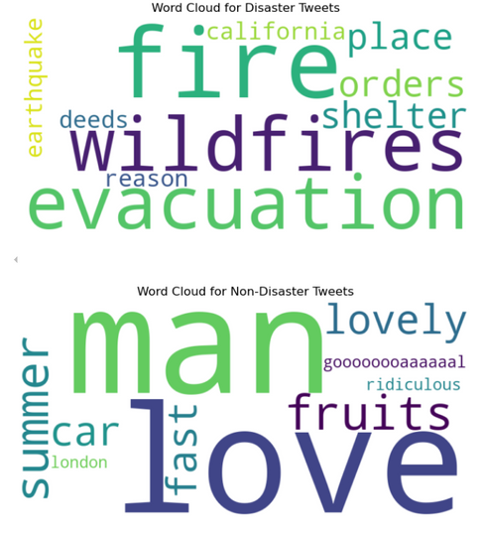
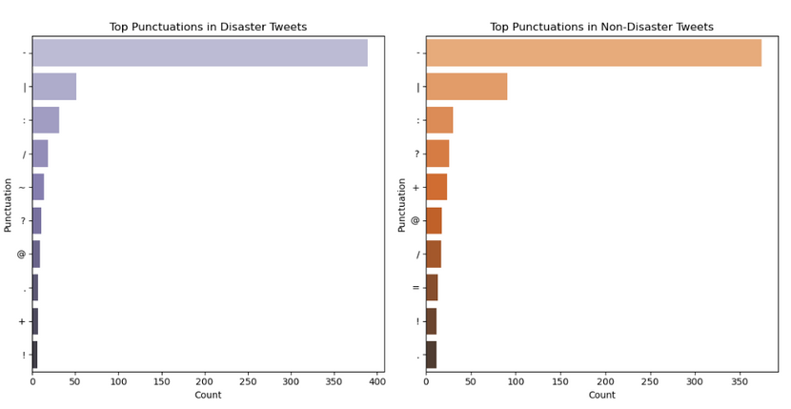
VISUALIZATIONS
WORD CLOUDS
WORD CLOUDS ARE GENERATED FOR BOTH DISASTER AND NON-DISASTER TWEETS TO HIGHLIGHT THE MOST FREQUENT TERMS, HELPING VISUALIZE THE PROMINENT KEYWORDS IN EACH CATEGORY.
PUNCTUATION ANALYSIS:
THE MOST COMMON PUNCTUATION MARKS IN BOTH DISASTER AND NON-DISASTER TWEETS ARE ANALYZED, WITH PLOTS SHOWING THAT SYMBOLS LIKE - AND | APPEAR FREQUENTLY..

Slide 7
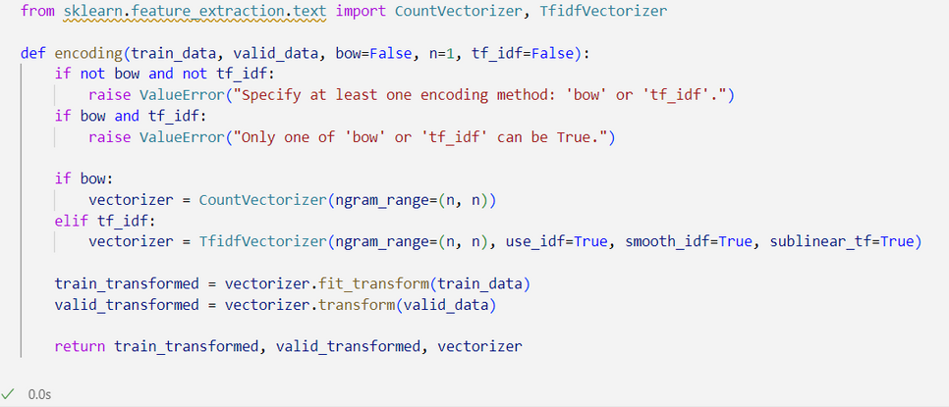
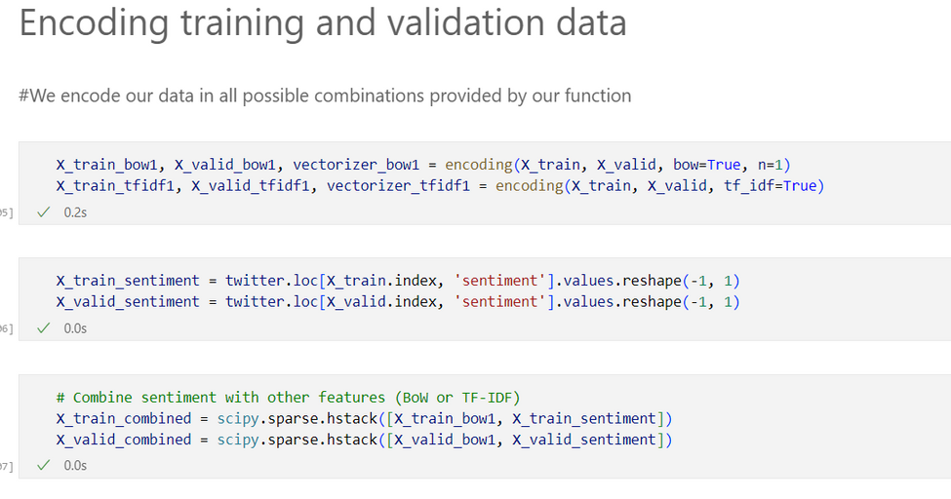
FEATURE ENGINEERING FOR MODEL INPUT
TF-IDF VECTORIZATION:
THE TFIDFVECTORIZER IS USED TO CONVERT THE CLEANED TEXT INTO NUMERICAL VECTORS, FOCUSING ON UNIGRAMS AND BIGRAMS AND LIMITING TO 5000 FEATURES.
THE TRAINING AND TEST SETS ARE TRANSFORMED USING FIT_TRANSFORM() FOR THE TRAINING DATA AND TRANSFORM() FOR THE TEST DATA.
COMBINING TF-IDF FEATURES WITH ADDITIONAL FEATURES:
THE TF-IDF FEATURES ARE COMBINED WITH THE ADDITIONAL FEATURES (TWEET_LENGTH, HASHTAG_COUNT, AND MENTION_COUNT) USING SCIPY.SPARSE.HSTACK() TO CREATE THE FINAL FEATURE SETS FOR TRAINING AND TESTING.
THE TRAINING AND TESTING DATA ARE SPLIT USING TRAIN_TEST_SPLIT TO CREATE DATASETS FOR MODEL EVALUATION.

Slide 8

MODELING
TEXT PREPROCESSING WITH TEXTBLOB
THE FUNCTION ADD_SENTIMENT_FEATURE(TWITTER_DF) ADDS A SENTIMENT POLARITY FEATURE TO A DATASET USING TEXTBLOB.
MODEL EVALUATION FUNCTIONS:
THE C_REPORT AND PLOT_CM FUNCTIONS ARE USED FOR EVALUATING MODELS. THEY PRINT OUT CLASSIFICATION REPORTS AND CONFUSION MATRICES.
MODEL DEFINITIONS:
MULTIPLE CLASSIFIERS SUCH AS LOGISTICREGRESSION, RANDOMFORESTCLASSIFIER, SVC, MULTINOMIALNB, XGBCLASSIFIER, CATBOOSTCLASSIFIER, AND A VOTINGCLASSIFIER ENSEMBLE. ALL THESE CLASSIFIERS ARE COMMON CHOICES FOR TEXT CLASSIFICATION TASKS.
TEXT ENCODING FUNCTIONS:
THE ENCODING FUNCTION ALLOWING US TO CHOOSE BETWEEN BAG OF WORDS (BOW) OR TF-IDF FOR VECTORIZING OUR TEXT. ADDITIONALLY, WE'RE MAKING SURE THAT ONLY ONE ENCODING METHOD IS SELECTED AT A TIME, WHICH AVOIDS CONFUSION.

Slide 9
COMBINING FEATURES:
COMBINING SENTIMENT WITH THE TEXT FEATURES (BOW OR TF-IDF), SHOULD ENRICH THE MODEL BY PROVIDING SENTIMENT INFORMATION ALONGSIDE THE TEXTUAL CONTENT.
TRAINING AND EVALUATING MODELS
USING THE TRAIN_MODEL FUNCTION TO FIT THE MODEL ON THE TRAINING DATA. THE PERFORMANCE OF EACH MODEL IS EVALUATED USING C_REPORT AND PLOT_CM.
ENSEMBLE LEARNING WITH VOTING CLASSIFIER:
USING A VOTINGCLASSIFIER WITH THREE MODELS: LOGISTIC REGRESSION, NAIVE BAYES, AND XGBOOST. THIS ENSEMBLE MODEL PROVIDE BETTER PERFORMANCE, AS IT COMBINES THE STRENGTHS OF EACH MODEL.
SAVING THE MODEL:
SAVING THE VOTINGCLASSIFIER MODEL USING JOBLIB.DUMP() AS IT ALLOWS US TO RELOAD THE MODEL FOR LATER USE.
BUBBLE CHART FOR MODEL COMPARISON:
BUBBLE CHART HAS BEEN USED TO VISUALIZE THE ACCURACY OF EACH MODEL. BECAUSE IT HELPS TO QUICKLY UNDERSTAND THE PERFORMANCE OF EACH CLASSIFIER IN COMPARISON TO OTHERS.

Slide 10
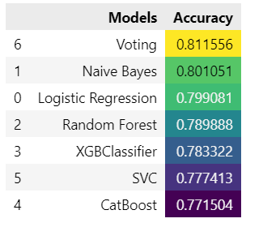
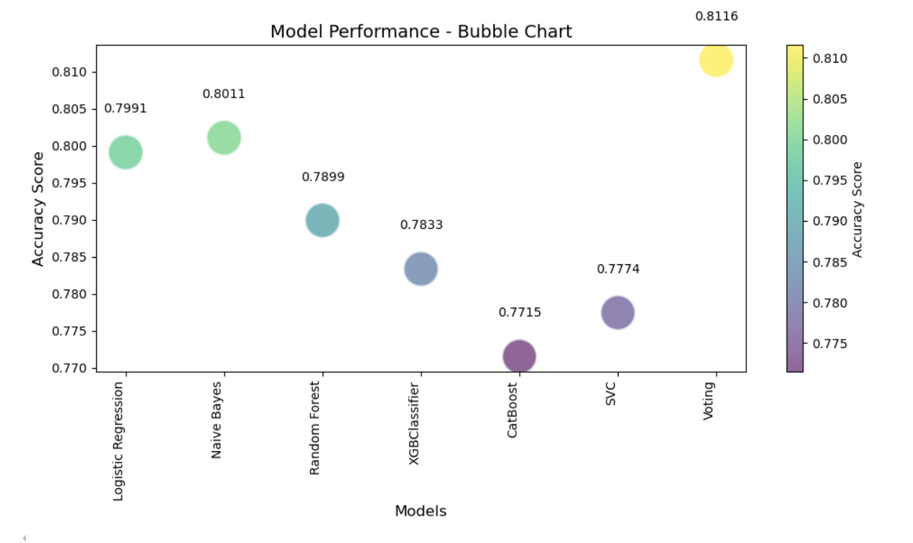

Slide 11
DEEP LEARNING AND TRADITIONAL MACHINE LEARNING TECHNIQUES

Slide 12
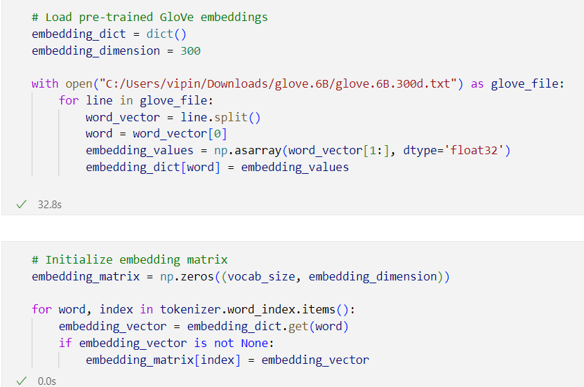
TEXT PREPROCESSING AND TOKENIZATION
TOKENIZER SETUP:
SET UP THE TOKENIZER FROM TENSORFLOW.KERAS.PREPROCESSING.TEXT AND TOKENIZED THE CLEANED INPUT TEXT (X_INP_CLEAN). THIS STEP IS ESSENTIAL FOR CONVERTING TEXT INTO A FORMAT THAT CAN BE USED BY MACHINE LEARNING MODELS.
EMBEDDING MATRIX WITH GLOVE:
WE ARE USING PRE-TRAINED GLOVE EMBEDDINGS FOR BETTER FEATURE REPRESENTATION OF WORDS. I LOADED THESE EMBEDDINGS, CREATED THE EMBEDDING MATRIX, AND THEN USED IT IN MY MODEL.

Slide 13
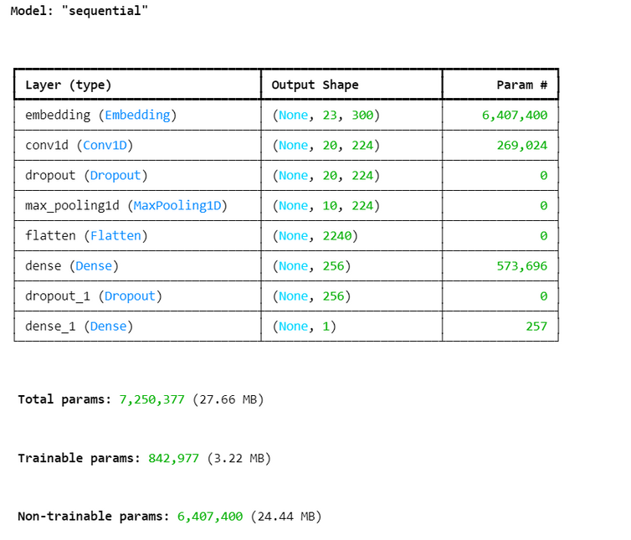
MODEL BUILDING
I IMPLEMENTED MULTIPLE MODELS AND ARE USING KERAS TUNER TO SEARCH FOR THE BEST HYPERPARAMETERS FOR THESE MODELS, INCLUDING:
CNN MODEL:
I CREATED A 1D CONVOLUTIONAL NEURAL NETWORK WITH HYPERPARAMETERS FOR THE NUMBER OF FILTERS, KERNEL SIZE, AND DENSE UNITS.
MULTICHANNEL CNN MODEL:
I COMBINED MULTIPLE 1D CONVOLUTIONS AND POOL LAYERS USING TWO INPUTS, WHICH CAN HELP CAPTURE DIFFERENT FEATURES FROM THE TEXT.
BILSTM MODEL:
I USED A BIDIRECTIONAL LSTM TO CAPTURE SEQUENTIAL DEPENDENCIES IN TEXT AND ADDED BATCH NORMALIZATION AND DROPOUT FOR REGULARIZATION.

Slide 14
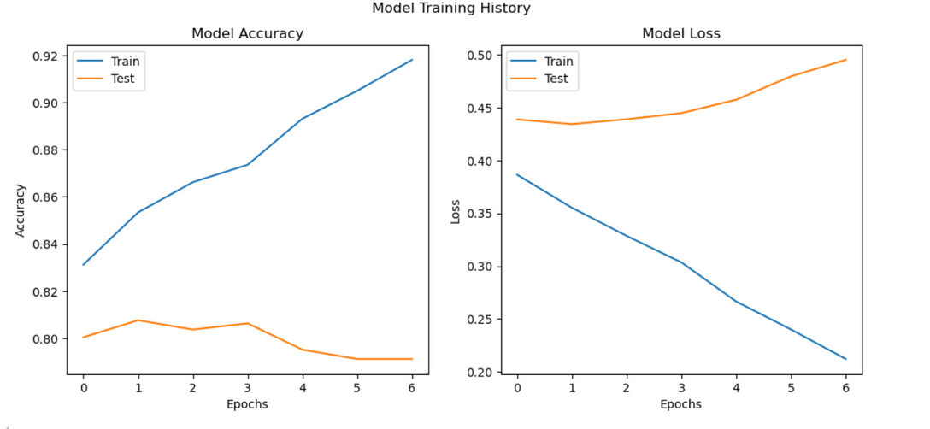
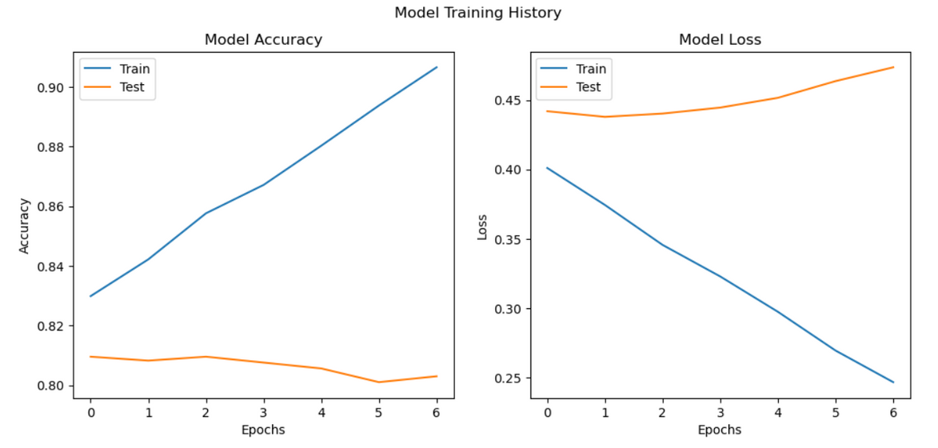
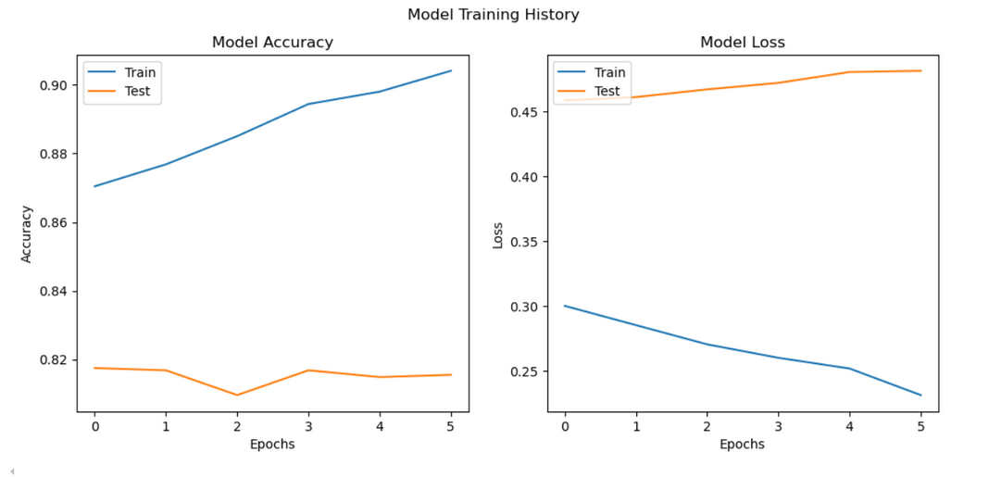

Slide 15
MODEL EVALUATION
AFTER TRAINING THE MODELS, I USED EARLYSTOPPING AND MODELCHECKPOINT TO AVOID OVERFITTING AND SAVE THE BEST MODEL.
DATA SPLITTING AND PIPELINE FOR TRADITIONAL MACHINE LEARNING:
I SPLIT MY DATA INTO TRAIN AND TEST SETS (X_TRAIN, X_TEST, Y_TRAIN, Y_TEST), WHICH IS ESSENTIAL FOR PROPER EVALUATION OF THE MODEL.
I HAVE ALSO CREATED A SCIKIT-LEARN PIPELINE FOR TEXT VECTORIZATION AND CLASSIFICATION USING A RANDOMFORESTCLASSIFIER. THIS IS A GOOD COMBINATION FOR TEXT CLASSIFICATION TASKS.
HOWEVER, IN A PIPELINE, I AM USING TFIDFVECTORIZER, WHICH WORKS WELL FOR CONVERTING TEXT INTO NUMERICAL FEATURES.
HYPERPARAMETER TUNING
I HAVE USED BOTH GRIDSEARCHCV AND RANDOMIZEDSEARCHCV FOR HYPERPARAMETER TUNING. THIS IS A SOLID APPROACH FOR TRADITIONAL MACHINE LEARNING MODELS LIKE RANDOMFOREST. BOTH METHODS HELP OPTIMIZE THE MODEL PARAMETERS:
GRIDSEARCHCV TRIES ALL COMBINATIONS OF HYPERPARAMETERS WITHIN THE GRID.
RANDOMIZEDSEARCHCV SAMPLES FROM THE HYPERPARAMETER SPACE, WHICH IS MORE EFFICIENT FOR LARGER SEARCH SPACES.

Slide 16
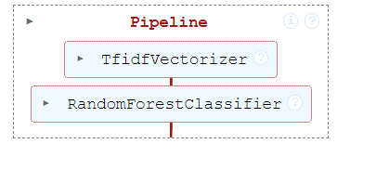
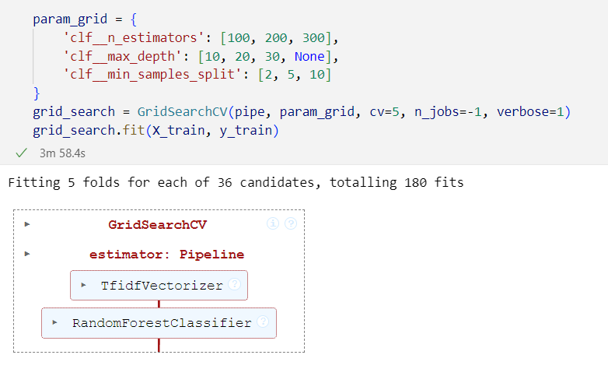
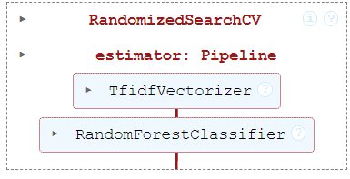

Slide 17
MODEL EVALUATION METRICS
AFTER TRAINING THE MODELS, I USED EARLYSTOPPING AND MODELCHECKPOINT TO AVOID OVERFITTING AND SAVE THE BEST MODEL.
CLASSIFICATION REPORT:
PROVIDES PRECISION, RECALL, F1-SCORE, AND ACCURACY, WHICH ARE ESSENTIAL FOR CLASSIFICATION TASKS, ESPECIALLY WHEN DEALING WITH IMBALANCED DATASETS.
ROC-AUC SCORE:
THE ROC-AUC SCORE IS AN EXCELLENT MEASURE OF HOW WELL MY MODEL CAN DISTINGUISH BETWEEN CLASSES, ESPECIALLY FOR BINARY CLASSIFICATION TASKS.
CONFUSION MATRIX:
A CONFUSION MATRIX IS A GREAT TOOL TO EVALUATE HOW WELL MY MODEL IS DISTINGUISHING BETWEEN THE CLASSES. THE HEATMAP VISUALIZATION MAKES IT EVEN EASIER TO INTERPRET.
LEARNING CURVES:
PLOTTING LEARNING CURVES IS A GOOD WAY TO UNDERSTAND IF MY MODEL IS OVERFITTING OR UNDERFITTING. IF THE TRAINING SCORE IS SIGNIFICANTLY HIGHER THAN THE CROSS-VALIDATION SCORE, IT MIGHT INDICATE OVERFITTING.

Slide 18
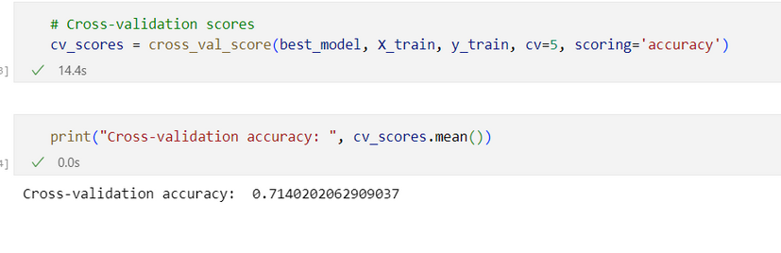
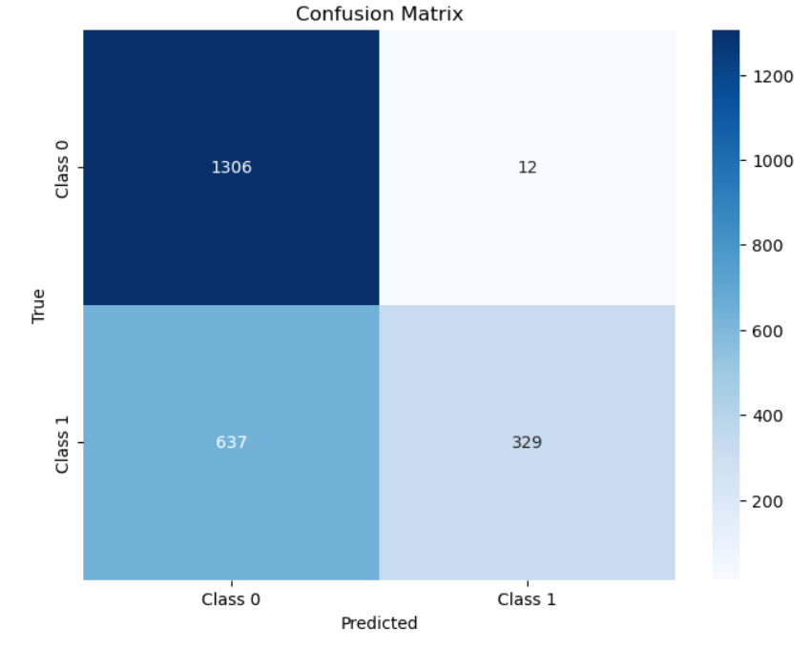
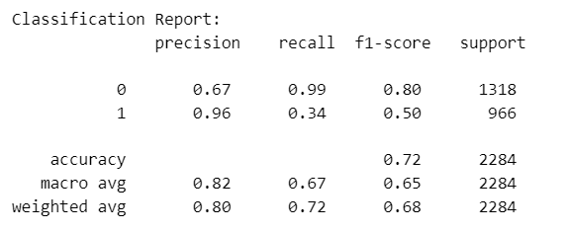
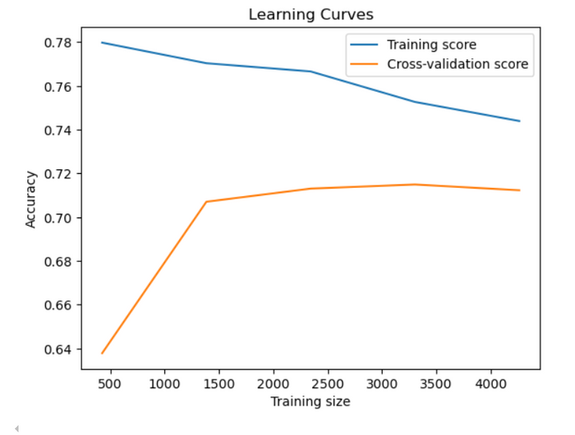

Slide 19


